Slide 1
SEQUENTIAL CIRCUIT DESIGN
3 BIT COUNTER using D AND JK Flip Flop
LECTURE 9

Slide 2
STEPS FOR SEQUENTIAL CIRCUIT DESIGN
State Diagram
Next State Table
State Reduction And Assignment
Flip Flop Transition Table (FLIP FLOP Selection)
Simplification
Input/output Equations
Implementations of Equation(Logic Diagram)

Slide 3
STATE DIAGRAM

Slide 4
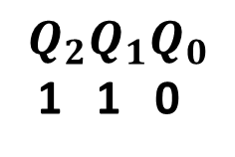
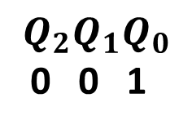
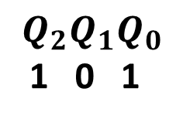
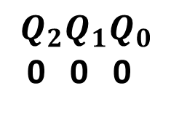
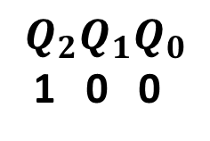
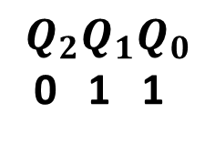
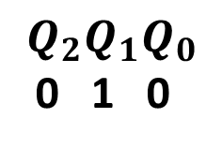
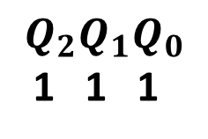
STATE DIAGRAM
$$Q_{2}Q_{1}Q_{0}$$
0 0 0
$$Q_{2}Q_{1}Q_{0}$$
1 1 1
$$Q_{2}Q_{1}Q_{0}$$
0 0 1
$$Q_{2}Q_{1}Q_{0}$$
1 1 0
$$Q_{2}Q_{1}Q_{0}$$
0 1 0
$$Q_{2}Q_{1}Q_{0}$$
1 0 1
$$Q_{2}Q_{1}Q_{0}$$
0 1 1
$$Q_{2}Q_{1}Q_{0}$$
1 0 0

Slide 5
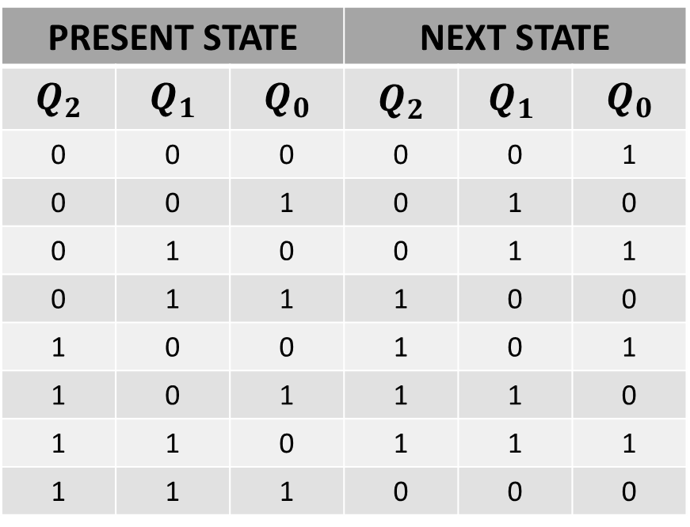
NEXT STATE TABLE
PRESENT STATE |  |  | NEXT STATE
$$Q_{2}$$ | $$Q_{1}$$ | $$Q_{0}$$ | $$Q_{2}$$ | $${Q_{1}}_{ }$$ | $$Q_{0}$$
0 | 0 | 0 | 0 | 0 | 1
0 | 0 | 1 | 0 | 1 | 0
0 | 1 | 0 | 0 | 1 | 1
0 | 1 | 1 | 1 | 0 | 0
1 | 0 | 0 | 1 | 0 | 1
1 | 0 | 1 | 1 | 1 | 0
1 | 1 | 0 | 1 | 1 | 1
1 | 1 | 1 | 0 | 0 | 0

Slide 6
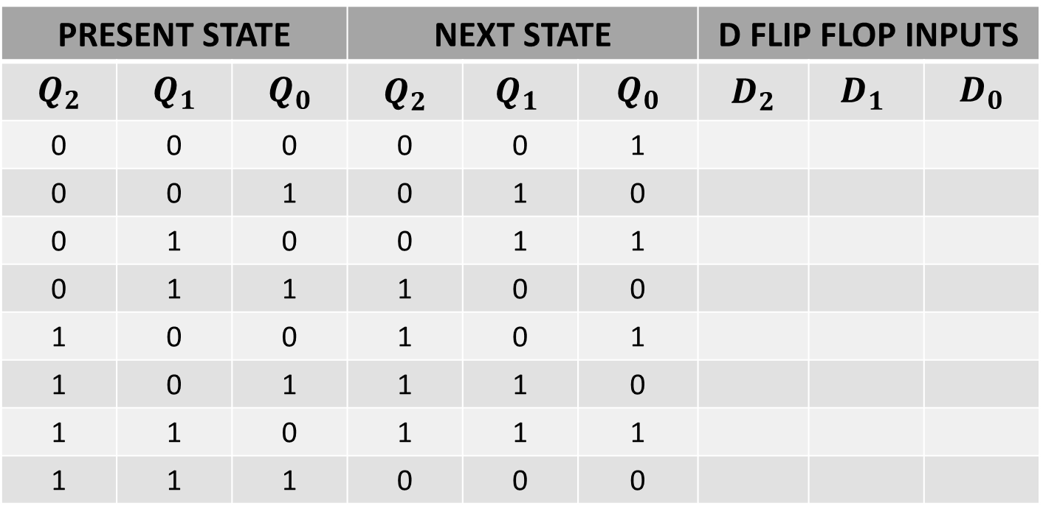
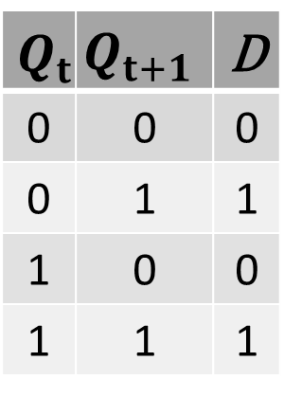
NEXT STATE TABLE USING D FLIP FLOP
$$Q_{t}$$ | $$Q_{t+1}$$ | D
0 | 0 | 0
0 | 1 | 1
1 | 0 | 0
1 | 1 | 1
PRESENT STATE |  |  | NEXT STATE |  |  | D FLIP FLOP INPUTS
$$Q_{2}$$ | $$Q_{1}$$ | $$Q_{0}$$ | $$Q_{2}$$ | $${Q_{1}}_{ }$$ | $$Q_{0}$$ | $$D_{2}$$ | $${D_{1}}_{ }$$ | $$D_{0}$$
0 | 0 | 0 | 0 | 0 | 1
0 | 0 | 1 | 0 | 1 | 0
0 | 1 | 0 | 0 | 1 | 1
0 | 1 | 1 | 1 | 0 | 0
1 | 0 | 0 | 1 | 0 | 1
1 | 0 | 1 | 1 | 1 | 0
1 | 1 | 0 | 1 | 1 | 1
1 | 1 | 1 | 0 | 0 | 0

Slide 7
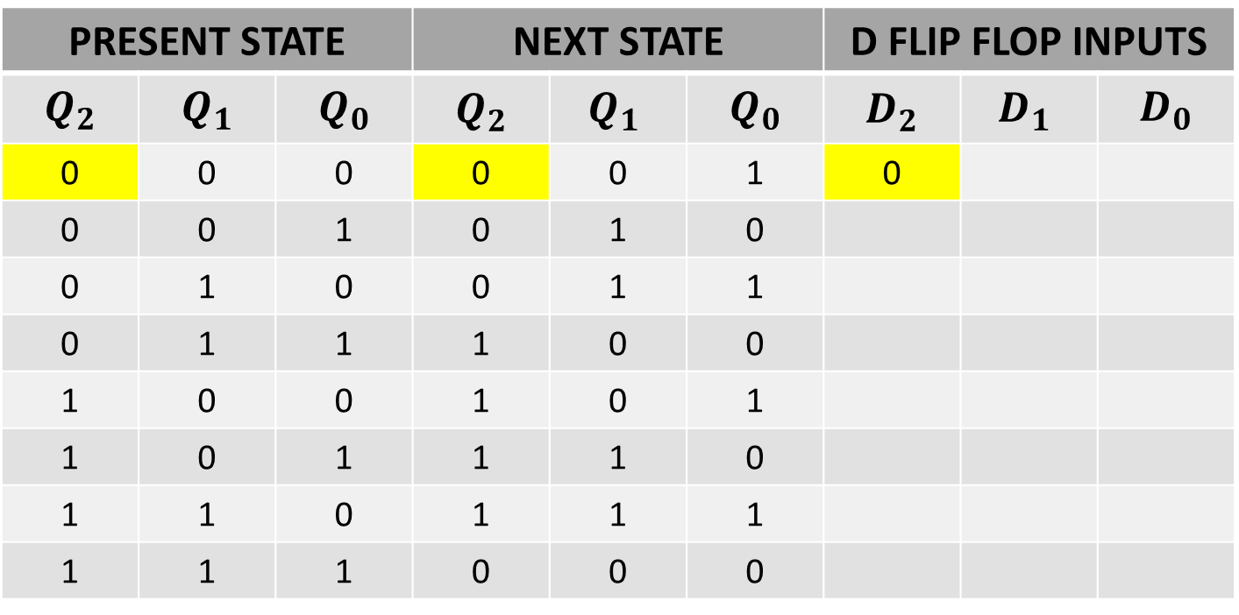
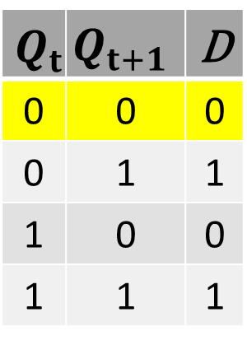
NEXT STATE TABLE USING D FLIP FLOP
$$Q_{t}$$ | $$Q_{t+1}$$ | D
0 | 0 | 0
0 | 1 | 1
1 | 0 | 0
1 | 1 | 1
PRESENT STATE |  |  | NEXT STATE |  |  | D FLIP FLOP INPUTS
$$Q_{2}$$ | $$Q_{1}$$ | $$Q_{0}$$ | $$Q_{2}$$ | $${Q_{1}}_{ }$$ | $$Q_{0}$$ | $$D_{2}$$ | $${D_{1}}_{ }$$ | $$D_{0}$$
0 | 0 | 0 | 0 | 0 | 1 | 0
0 | 0 | 1 | 0 | 1 | 0
0 | 1 | 0 | 0 | 1 | 1
0 | 1 | 1 | 1 | 0 | 0
1 | 0 | 0 | 1 | 0 | 1
1 | 0 | 1 | 1 | 1 | 0
1 | 1 | 0 | 1 | 1 | 1
1 | 1 | 1 | 0 | 0 | 0

Slide 8
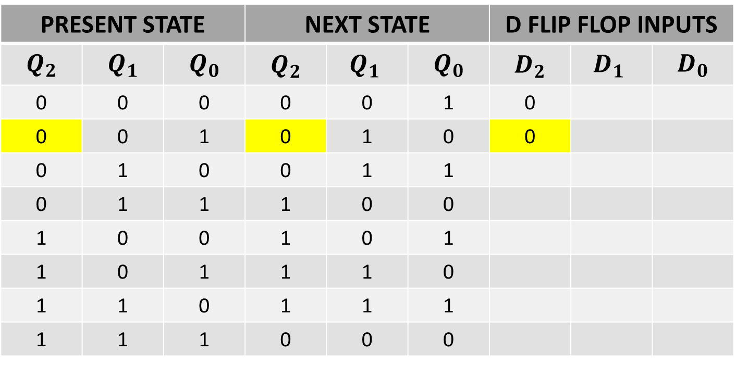
NEXT STATE TABLE USING D FLIP FLOP
$$Q_{t}$$ | $$Q_{t+1}$$ | D
0 | 0 | 0
0 | 1 | 1
1 | 0 | 0
1 | 1 | 1
PRESENT STATE |  |  | NEXT STATE |  |  | D FLIP FLOP INPUTS
$$Q_{2}$$ | $$Q_{1}$$ | $$Q_{0}$$ | $$Q_{2}$$ | $${Q_{1}}_{ }$$ | $$Q_{0}$$ | $$D_{2}$$ | $${D_{1}}_{ }$$ | $$D_{0}$$
0 | 0 | 0 | 0 | 0 | 1 | 0
0 | 0 | 1 | 0 | 1 | 0 | 0
0 | 1 | 0 | 0 | 1 | 1
0 | 1 | 1 | 1 | 0 | 0
1 | 0 | 0 | 1 | 0 | 1
1 | 0 | 1 | 1 | 1 | 0
1 | 1 | 0 | 1 | 1 | 1
1 | 1 | 1 | 0 | 0 | 0

Slide 9
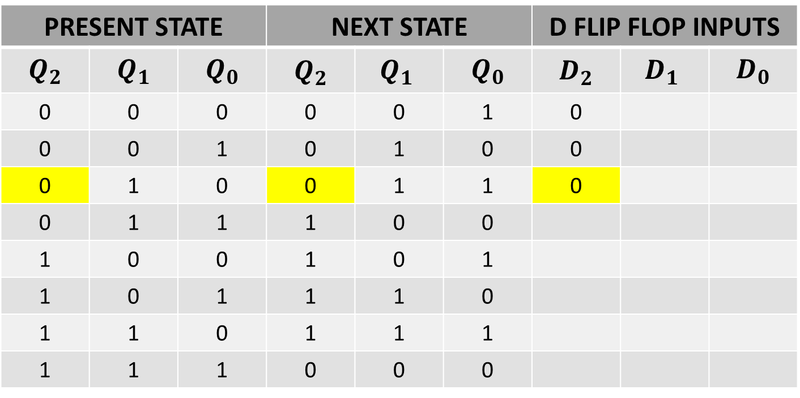
NEXT STATE TABLE USING D FLIP FLOP
$$Q_{t}$$ | $$Q_{t+1}$$ | D
0 | 0 | 0
0 | 1 | 1
1 | 0 | 0
1 | 1 | 1
PRESENT STATE |  |  | NEXT STATE |  |  | D FLIP FLOP INPUTS
$$Q_{2}$$ | $$Q_{1}$$ | $$Q_{0}$$ | $$Q_{2}$$ | $${Q_{1}}_{ }$$ | $$Q_{0}$$ | $$D_{2}$$ | $${D_{1}}_{ }$$ | $$D_{0}$$
0 | 0 | 0 | 0 | 0 | 1 | 0
0 | 0 | 1 | 0 | 1 | 0 | 0
0 | 1 | 0 | 0 | 1 | 1 | 0
0 | 1 | 1 | 1 | 0 | 0
1 | 0 | 0 | 1 | 0 | 1
1 | 0 | 1 | 1 | 1 | 0
1 | 1 | 0 | 1 | 1 | 1
1 | 1 | 1 | 0 | 0 | 0

Slide 10
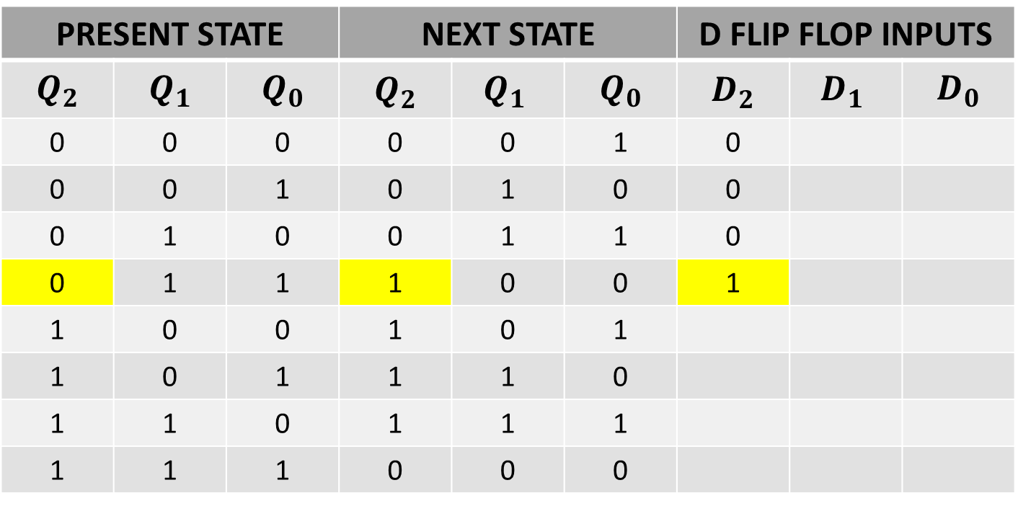
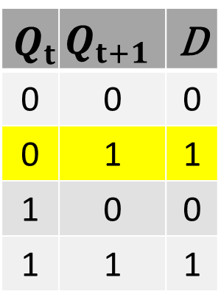
NEXT STATE TABLE USING D FLIP FLOP
$$Q_{t}$$ | $$Q_{t+1}$$ | D
0 | 0 | 0
0 | 1 | 1
1 | 0 | 0
1 | 1 | 1
PRESENT STATE |  |  | NEXT STATE |  |  | D FLIP FLOP INPUTS
$$Q_{2}$$ | $$Q_{1}$$ | $$Q_{0}$$ | $$Q_{2}$$ | $${Q_{1}}_{ }$$ | $$Q_{0}$$ | $$D_{2}$$ | $${D_{1}}_{ }$$ | $$D_{0}$$
0 | 0 | 0 | 0 | 0 | 1 | 0
0 | 0 | 1 | 0 | 1 | 0 | 0
0 | 1 | 0 | 0 | 1 | 1 | 0
0 | 1 | 1 | 1 | 0 | 0 | 1
1 | 0 | 0 | 1 | 0 | 1
1 | 0 | 1 | 1 | 1 | 0
1 | 1 | 0 | 1 | 1 | 1
1 | 1 | 1 | 0 | 0 | 0

Slide 11
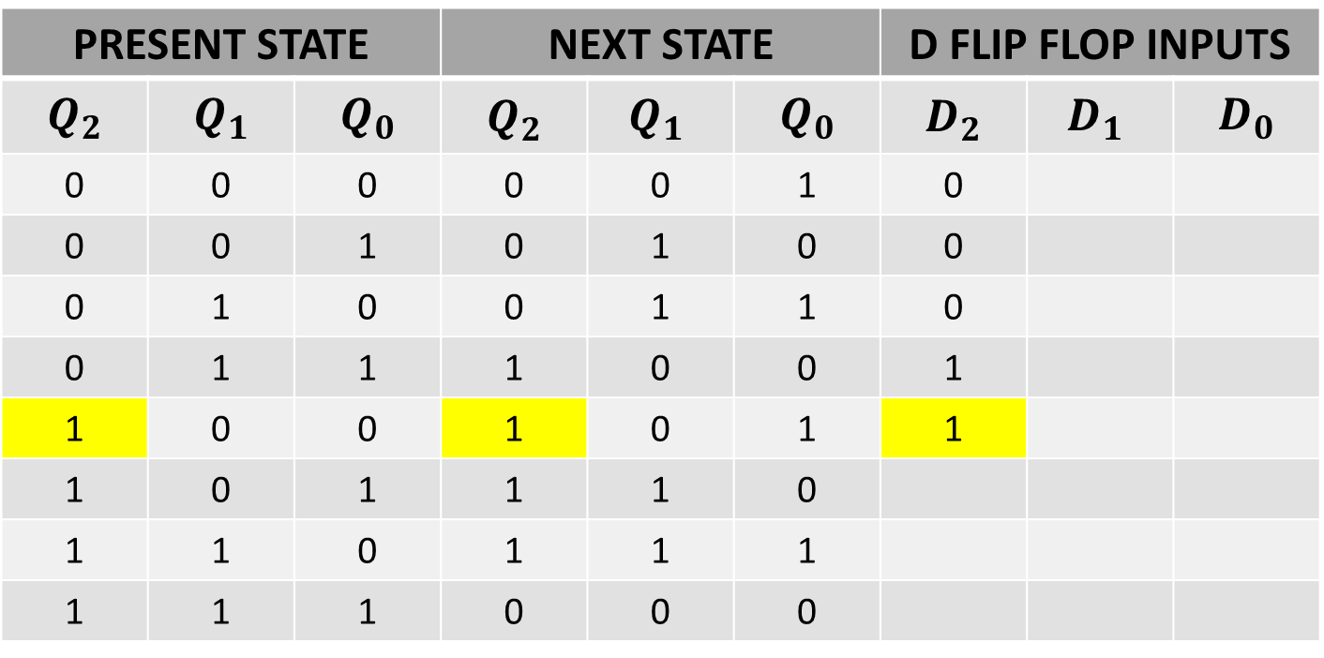
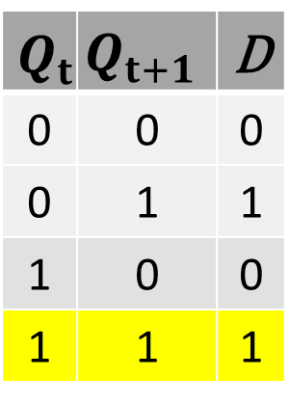
NEXT STATE TABLE USING D FLIP FLOP
$$Q_{t}$$ | $$Q_{t+1}$$ | D
0 | 0 | 0
0 | 1 | 1
1 | 0 | 0
1 | 1 | 1
PRESENT STATE |  |  | NEXT STATE |  |  | D FLIP FLOP INPUTS
$$Q_{2}$$ | $$Q_{1}$$ | $$Q_{0}$$ | $$Q_{2}$$ | $${Q_{1}}_{ }$$ | $$Q_{0}$$ | $$D_{2}$$ | $${D_{1}}_{ }$$ | $$D_{0}$$
0 | 0 | 0 | 0 | 0 | 1 | 0
0 | 0 | 1 | 0 | 1 | 0 | 0
0 | 1 | 0 | 0 | 1 | 1 | 0
0 | 1 | 1 | 1 | 0 | 0 | 1
1 | 0 | 0 | 1 | 0 | 1 | 1
1 | 0 | 1 | 1 | 1 | 0
1 | 1 | 0 | 1 | 1 | 1
1 | 1 | 1 | 0 | 0 | 0

Slide 12
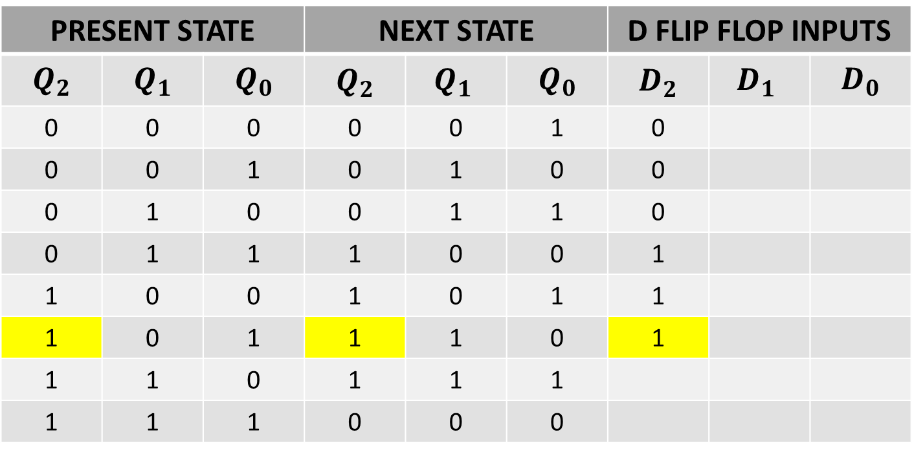
NEXT STATE TABLE USING D FLIP FLOP
$$Q_{t}$$ | $$Q_{t+1}$$ | D
0 | 0 | 0
0 | 1 | 1
1 | 0 | 0
1 | 1 | 1
PRESENT STATE |  |  | NEXT STATE |  |  | D FLIP FLOP INPUTS
$$Q_{2}$$ | $$Q_{1}$$ | $$Q_{0}$$ | $$Q_{2}$$ | $${Q_{1}}_{ }$$ | $$Q_{0}$$ | $$D_{2}$$ | $${D_{1}}_{ }$$ | $$D_{0}$$
0 | 0 | 0 | 0 | 0 | 1 | 0
0 | 0 | 1 | 0 | 1 | 0 | 0
0 | 1 | 0 | 0 | 1 | 1 | 0
0 | 1 | 1 | 1 | 0 | 0 | 1
1 | 0 | 0 | 1 | 0 | 1 | 1
1 | 0 | 1 | 1 | 1 | 0 | 1
1 | 1 | 0 | 1 | 1 | 1
1 | 1 | 1 | 0 | 0 | 0

Slide 13
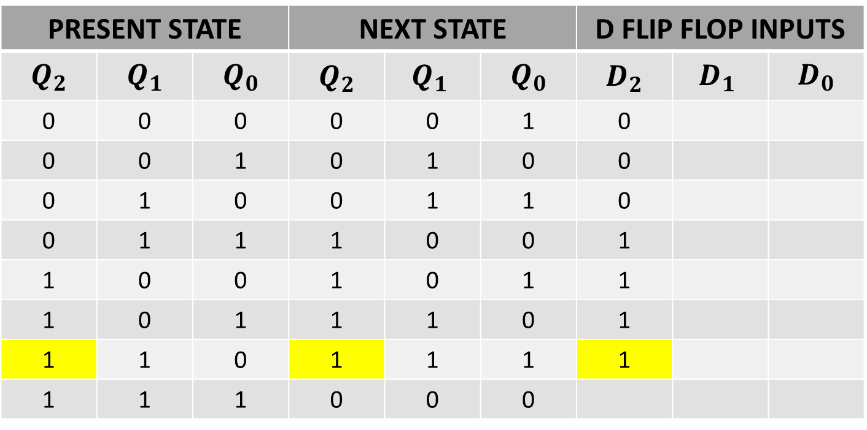
NEXT STATE TABLE USING D FLIP FLOP
$$Q_{t}$$ | $$Q_{t+1}$$ | D
0 | 0 | 0
0 | 1 | 1
1 | 0 | 0
1 | 1 | 1
PRESENT STATE |  |  | NEXT STATE |  |  | D FLIP FLOP INPUTS
$$Q_{2}$$ | $$Q_{1}$$ | $$Q_{0}$$ | $$Q_{2}$$ | $${Q_{1}}_{ }$$ | $$Q_{0}$$ | $$D_{2}$$ | $${D_{1}}_{ }$$ | $$D_{0}$$
0 | 0 | 0 | 0 | 0 | 1 | 0
0 | 0 | 1 | 0 | 1 | 0 | 0
0 | 1 | 0 | 0 | 1 | 1 | 0
0 | 1 | 1 | 1 | 0 | 0 | 1
1 | 0 | 0 | 1 | 0 | 1 | 1
1 | 0 | 1 | 1 | 1 | 0 | 1
1 | 1 | 0 | 1 | 1 | 1 | 1
1 | 1 | 1 | 0 | 0 | 0

Slide 14
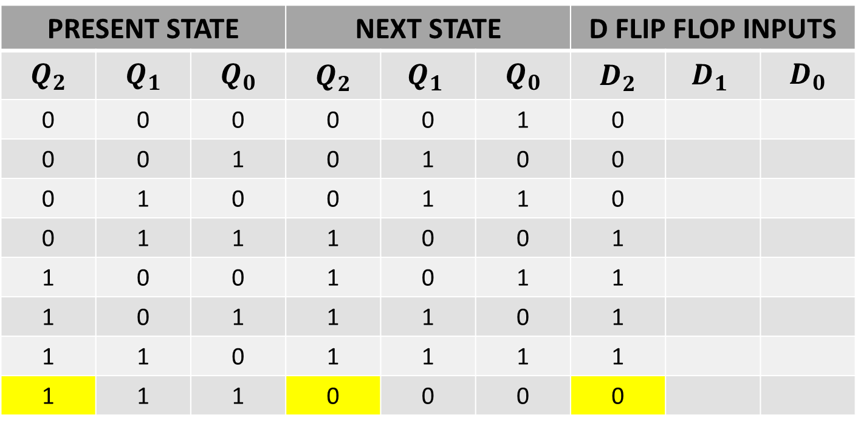
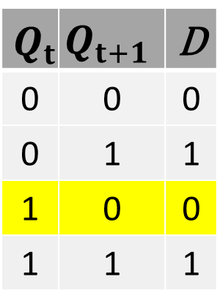
NEXT STATE TABLE USING D FLIP FLOP
$$Q_{t}$$ | $$Q_{t+1}$$ | D
0 | 0 | 0
0 | 1 | 1
1 | 0 | 0
1 | 1 | 1
PRESENT STATE |  |  | NEXT STATE |  |  | D FLIP FLOP INPUTS
$$Q_{2}$$ | $$Q_{1}$$ | $$Q_{0}$$ | $$Q_{2}$$ | $${Q_{1}}_{ }$$ | $$Q_{0}$$ | $$D_{2}$$ | $${D_{1}}_{ }$$ | $$D_{0}$$
0 | 0 | 0 | 0 | 0 | 1 | 0
0 | 0 | 1 | 0 | 1 | 0 | 0
0 | 1 | 0 | 0 | 1 | 1 | 0
0 | 1 | 1 | 1 | 0 | 0 | 1
1 | 0 | 0 | 1 | 0 | 1 | 1
1 | 0 | 1 | 1 | 1 | 0 | 1
1 | 1 | 0 | 1 | 1 | 1 | 1
1 | 1 | 1 | 0 | 0 | 0 | 0

Slide 15
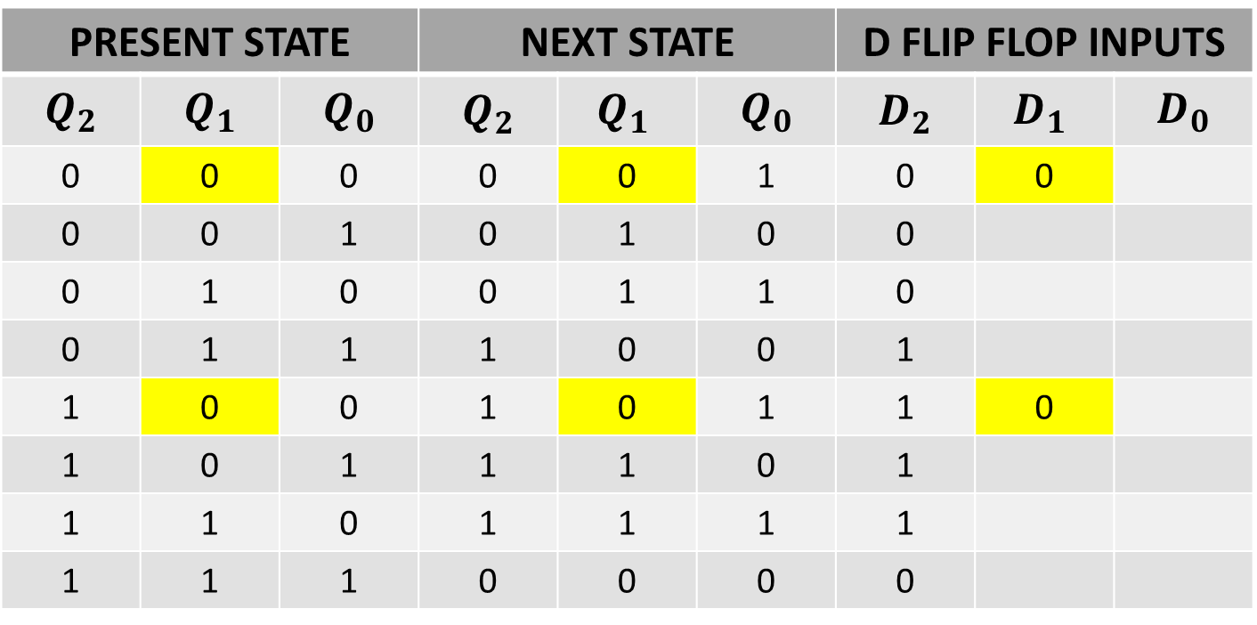
NEXT STATE TABLE USING D FLIP FLOP
$$Q_{t}$$ | $$Q_{t+1}$$ | D
0 | 0 | 0
0 | 1 | 1
1 | 0 | 0
1 | 1 | 1
PRESENT STATE |  |  | NEXT STATE |  |  | D FLIP FLOP INPUTS
$$Q_{2}$$ | $$Q_{1}$$ | $$Q_{0}$$ | $$Q_{2}$$ | $${Q_{1}}_{ }$$ | $$Q_{0}$$ | $$D_{2}$$ | $${D_{1}}_{ }$$ | $$D_{0}$$
0 | 0 | 0 | 0 | 0 | 1 | 0 | 0
0 | 0 | 1 | 0 | 1 | 0 | 0
0 | 1 | 0 | 0 | 1 | 1 | 0
0 | 1 | 1 | 1 | 0 | 0 | 1
1 | 0 | 0 | 1 | 0 | 1 | 1 | 0
1 | 0 | 1 | 1 | 1 | 0 | 1
1 | 1 | 0 | 1 | 1 | 1 | 1
1 | 1 | 1 | 0 | 0 | 0 | 0

Slide 16
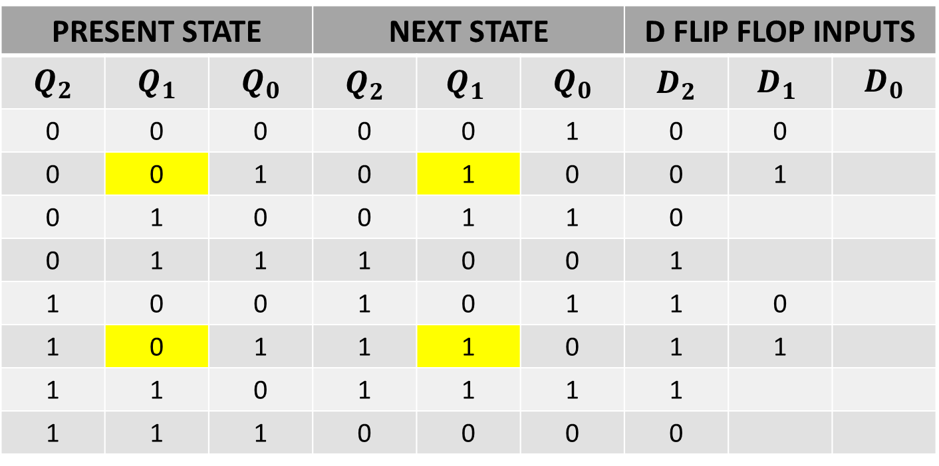
NEXT STATE TABLE USING D FLIP FLOP
$$Q_{t}$$ | $$Q_{t+1}$$ | D
0 | 0 | 0
0 | 1 | 1
1 | 0 | 0
1 | 1 | 1
PRESENT STATE |  |  | NEXT STATE |  |  | D FLIP FLOP INPUTS
$$Q_{2}$$ | $$Q_{1}$$ | $$Q_{0}$$ | $$Q_{2}$$ | $${Q_{1}}_{ }$$ | $$Q_{0}$$ | $$D_{2}$$ | $${D_{1}}_{ }$$ | $$D_{0}$$
0 | 0 | 0 | 0 | 0 | 1 | 0 | 0
0 | 0 | 1 | 0 | 1 | 0 | 0 | 1
0 | 1 | 0 | 0 | 1 | 1 | 0
0 | 1 | 1 | 1 | 0 | 0 | 1
1 | 0 | 0 | 1 | 0 | 1 | 1 | 0
1 | 0 | 1 | 1 | 1 | 0 | 1 | 1
1 | 1 | 0 | 1 | 1 | 1 | 1
1 | 1 | 1 | 0 | 0 | 0 | 0

Slide 17
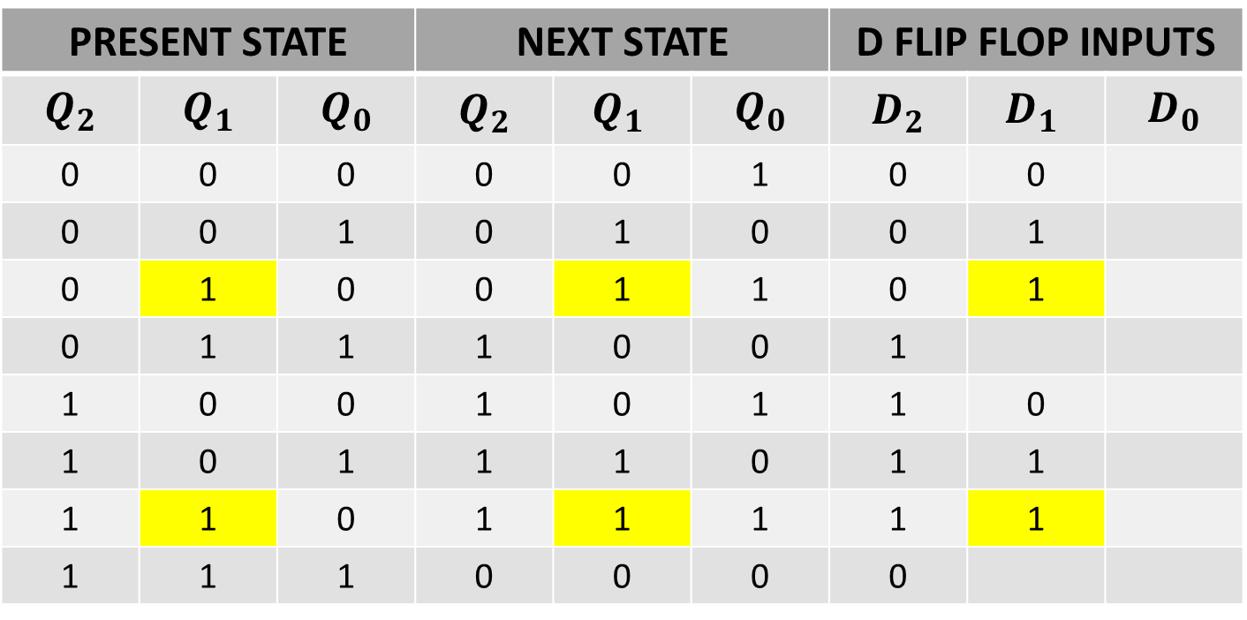
NEXT STATE TABLE USING D FLIP FLOP
$$Q_{t}$$ | $$Q_{t+1}$$ | D
0 | 0 | 0
0 | 1 | 1
1 | 0 | 0
1 | 1 | 1
PRESENT STATE |  |  | NEXT STATE |  |  | D FLIP FLOP INPUTS
$$Q_{2}$$ | $$Q_{1}$$ | $$Q_{0}$$ | $$Q_{2}$$ | $${Q_{1}}_{ }$$ | $$Q_{0}$$ | $$D_{2}$$ | $${D_{1}}_{ }$$ | $$D_{0}$$
0 | 0 | 0 | 0 | 0 | 1 | 0 | 0
0 | 0 | 1 | 0 | 1 | 0 | 0 | 1
0 | 1 | 0 | 0 | 1 | 1 | 0 | 1
0 | 1 | 1 | 1 | 0 | 0 | 1
1 | 0 | 0 | 1 | 0 | 1 | 1 | 0
1 | 0 | 1 | 1 | 1 | 0 | 1 | 1
1 | 1 | 0 | 1 | 1 | 1 | 1 | 1
1 | 1 | 1 | 0 | 0 | 0 | 0

Slide 18
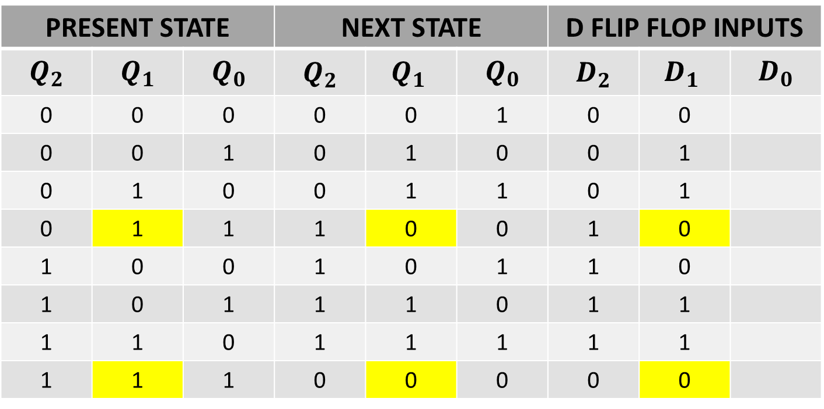
NEXT STATE TABLE USING D FLIP FLOP
$$Q_{t}$$ | $$Q_{t+1}$$ | D
0 | 0 | 0
0 | 1 | 1
1 | 0 | 0
1 | 1 | 1
PRESENT STATE |  |  | NEXT STATE |  |  | D FLIP FLOP INPUTS
$$Q_{2}$$ | $$Q_{1}$$ | $$Q_{0}$$ | $$Q_{2}$$ | $${Q_{1}}_{ }$$ | $$Q_{0}$$ | $$D_{2}$$ | $${D_{1}}_{ }$$ | $$D_{0}$$
0 | 0 | 0 | 0 | 0 | 1 | 0 | 0
0 | 0 | 1 | 0 | 1 | 0 | 0 | 1
0 | 1 | 0 | 0 | 1 | 1 | 0 | 1
0 | 1 | 1 | 1 | 0 | 0 | 1 | 0
1 | 0 | 0 | 1 | 0 | 1 | 1 | 0
1 | 0 | 1 | 1 | 1 | 0 | 1 | 1
1 | 1 | 0 | 1 | 1 | 1 | 1 | 1
1 | 1 | 1 | 0 | 0 | 0 | 0 | 0

Slide 19
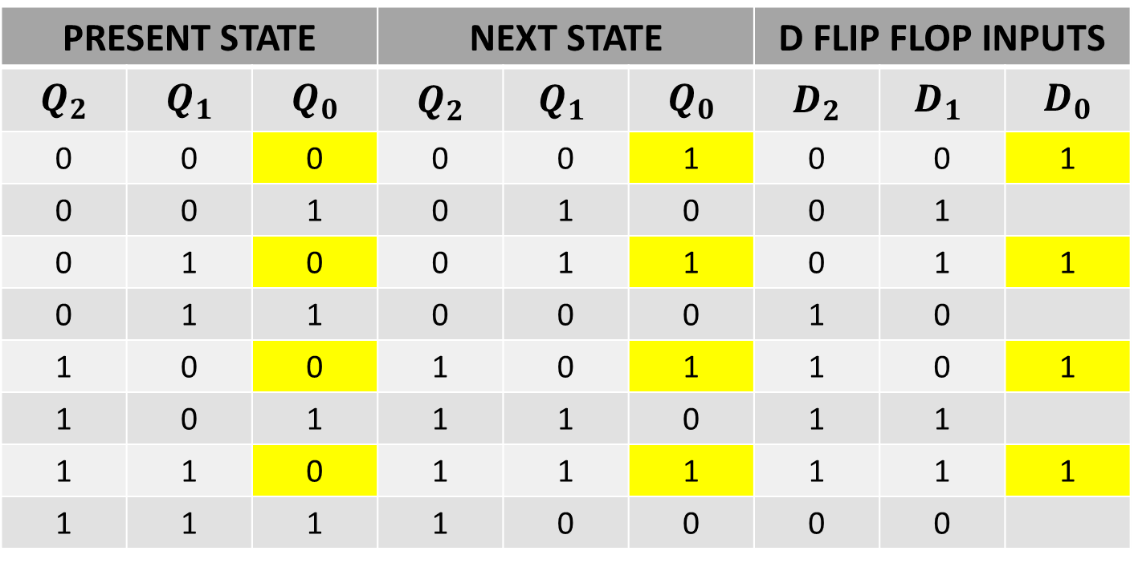
NEXT STATE TABLE USING D FLIP FLOP
$$Q_{t}$$ | $$Q_{t+1}$$ | D
0 | 0 | 0
0 | 1 | 1
1 | 0 | 0
1 | 1 | 1
PRESENT STATE |  |  | NEXT STATE |  |  | D FLIP FLOP INPUTS
$$Q_{2}$$ | $$Q_{1}$$ | $$Q_{0}$$ | $$Q_{2}$$ | $${Q_{1}}_{ }$$ | $$Q_{0}$$ | $$D_{2}$$ | $${D_{1}}_{ }$$ | $$D_{0}$$
0 | 0 | 0 | 0 | 0 | 1 | 0 | 0 | 1
0 | 0 | 1 | 0 | 1 | 0 | 0 | 1
0 | 1 | 0 | 0 | 1 | 1 | 0 | 1 | 1
0 | 1 | 1 | 0 | 0 | 0 | 1 | 0
1 | 0 | 0 | 1 | 0 | 1 | 1 | 0 | 1
1 | 0 | 1 | 1 | 1 | 0 | 1 | 1
1 | 1 | 0 | 1 | 1 | 1 | 1 | 1 | 1
1 | 1 | 1 | 1 | 0 | 0 | 0 | 0

Slide 20
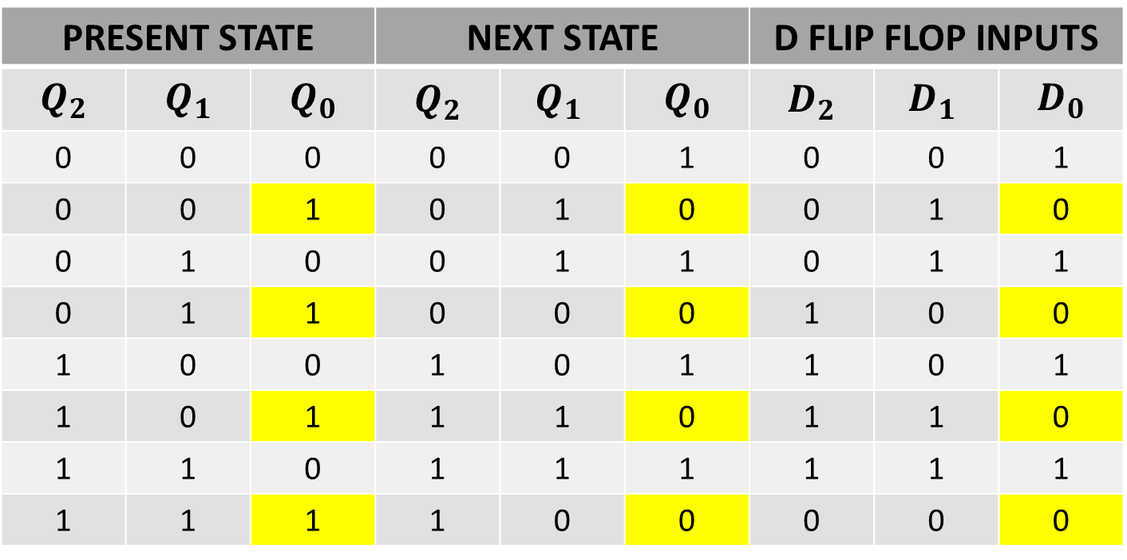
NEXT STATE TABLE USING D FLIP FLOP
$$Q_{t}$$ | $$Q_{t+1}$$ | D
0 | 0 | 0
0 | 1 | 1
1 | 0 | 0
1 | 1 | 1
PRESENT STATE |  |  | NEXT STATE |  |  | D FLIP FLOP INPUTS
$$Q_{2}$$ | $$Q_{1}$$ | $$Q_{0}$$ | $$Q_{2}$$ | $${Q_{1}}_{ }$$ | $$Q_{0}$$ | $$D_{2}$$ | $${D_{1}}_{ }$$ | $$D_{0}$$
0 | 0 | 0 | 0 | 0 | 1 | 0 | 0 | 1
0 | 0 | 1 | 0 | 1 | 0 | 0 | 1 | 0
0 | 1 | 0 | 0 | 1 | 1 | 0 | 1 | 1
0 | 1 | 1 | 0 | 0 | 0 | 1 | 0 | 0
1 | 0 | 0 | 1 | 0 | 1 | 1 | 0 | 1
1 | 0 | 1 | 1 | 1 | 0 | 1 | 1 | 0
1 | 1 | 0 | 1 | 1 | 1 | 1 | 1 | 1
1 | 1 | 1 | 1 | 0 | 0 | 0 | 0 | 0

Slide 21
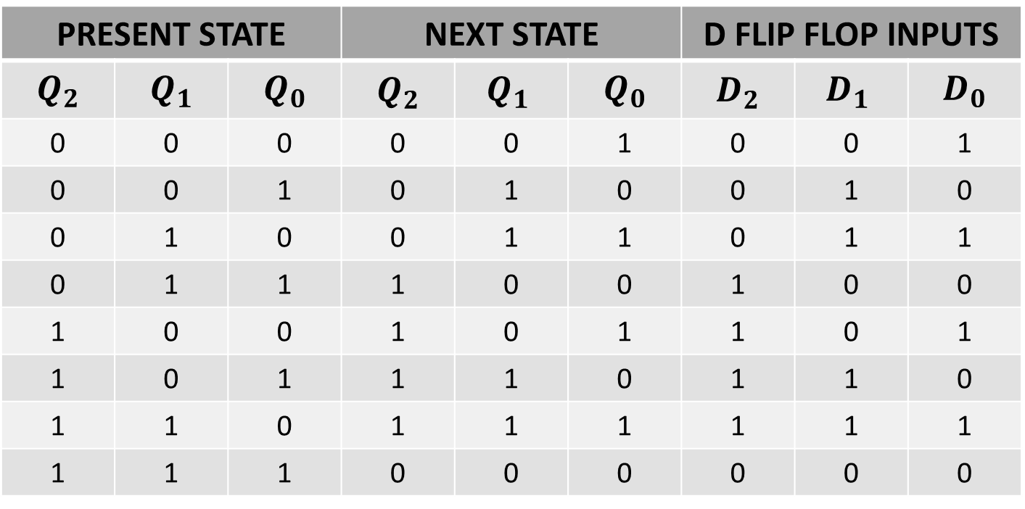
NEXT STATE TABLE USING D FLIP FLOP
PRESENT STATE |  |  | NEXT STATE |  |  | D FLIP FLOP INPUTS
$$Q_{2}$$ | $$Q_{1}$$ | $$Q_{0}$$ | $$Q_{2}$$ | $${Q_{1}}_{ }$$ | $$Q_{0}$$ | $$D_{2}$$ | $${D_{1}}_{ }$$ | $$D_{0}$$
0 | 0 | 0 | 0 | 0 | 1 | 0 | 0 | 1
0 | 0 | 1 | 0 | 1 | 0 | 0 | 1 | 0
0 | 1 | 0 | 0 | 1 | 1 | 0 | 1 | 1
0 | 1 | 1 | 1 | 0 | 0 | 1 | 0 | 0
1 | 0 | 0 | 1 | 0 | 1 | 1 | 0 | 1
1 | 0 | 1 | 1 | 1 | 0 | 1 | 1 | 0
1 | 1 | 0 | 1 | 1 | 1 | 1 | 1 | 1
1 | 1 | 1 | 0 | 0 | 0 | 0 | 0 | 0

Slide 22
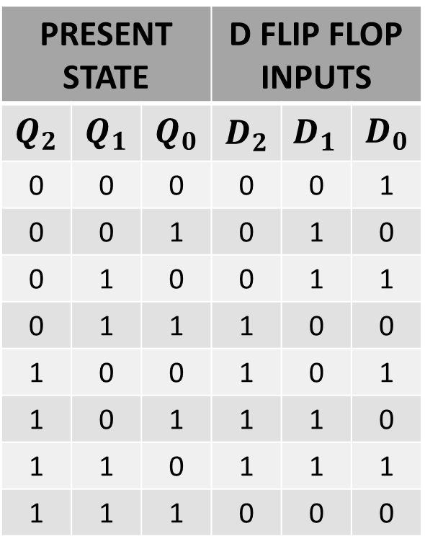
NEXT STATE TABLE USING D FLIP FLOP
PRESENT STATE |  |  | D FLIP FLOP INPUTS
$$Q_{2}$$ | $$Q_{1}$$ | $$Q_{0}$$ | $$D_{2}$$ | $${D_{1}}_{ }$$ | $$D_{0}$$
0 | 0 | 0 | 0 | 0 | 1
0 | 0 | 1 | 0 | 1 | 0
0 | 1 | 0 | 0 | 1 | 1
0 | 1 | 1 | 1 | 0 | 0
1 | 0 | 0 | 1 | 0 | 1
1 | 0 | 1 | 1 | 1 | 0
1 | 1 | 0 | 1 | 1 | 1
1 | 1 | 1 | 0 | 0 | 0

Slide 23
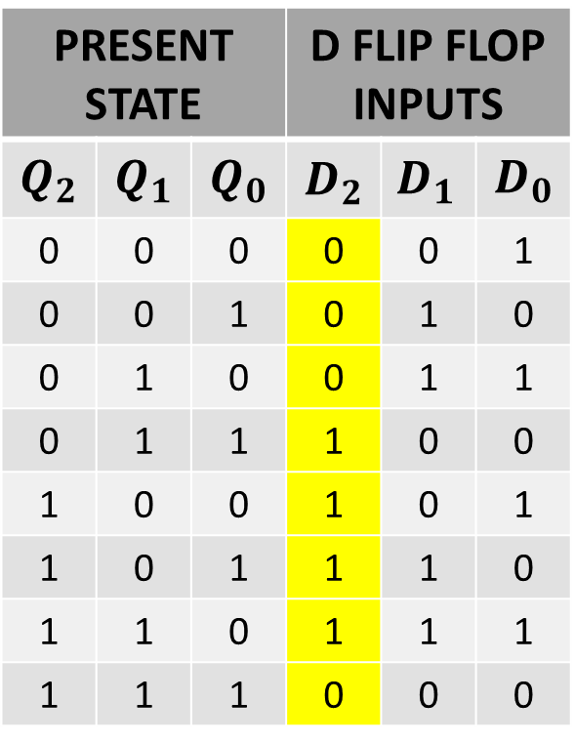
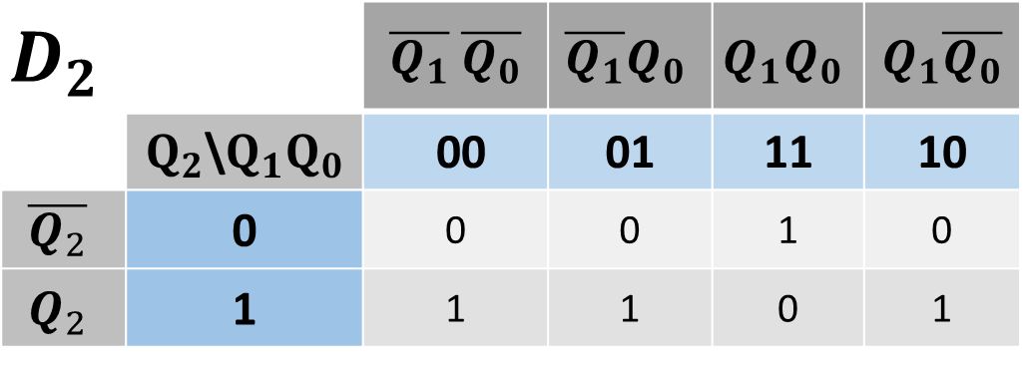
SIMPLIFICATION(K-MAP)
PRESENT STATE |  |  | D FLIP FLOP INPUTS
$$Q_{2}$$ | $$Q_{1}$$ | $$Q_{0}$$ | $$D_{2}$$ | $${D_{1}}_{ }$$ | $$D_{0}$$
0 | 0 | 0 | 0 | 0 | 1
0 | 0 | 1 | 0 | 1 | 0
0 | 1 | 0 | 0 | 1 | 1
0 | 1 | 1 | 1 | 0 | 0
1 | 0 | 0 | 1 | 0 | 1
1 | 0 | 1 | 1 | 1 | 0
1 | 1 | 0 | 1 | 1 | 1
1 | 1 | 1 | 0 | 0 | 0
$$D_{2}$$ |  | $\overline{Q_{1}}$ $\overline{Q_{0}}$ | $$\overline{Q_{1}}Q_{0}$$ | $$Q_{1}Q_{0}$$ | $Q_{1}\overline{Q_{0}}$
 | $Q_{2}$\$Q_{1}Q_{0}$ | 00 | 01 | 11 | 10
$$\overline{Q_{2}}$$ | 0 | 0 | 0 | 1 | 0
$$Q_{2}$$ | 1 | 1 | 1 | 0 | 1

Slide 24
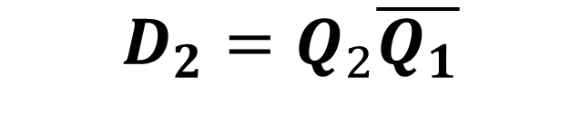
SIMPLIFICATION(K-MAP)
PRESENT STATE |  |  | D FLIP FLOP INPUTS
$$Q_{2}$$ | $$Q_{1}$$ | $$Q_{0}$$ | $$D_{2}$$ | $${D_{1}}_{ }$$ | $$D_{0}$$
0 | 0 | 0 | 0 | 0 | 1
0 | 0 | 1 | 0 | 1 | 0
0 | 1 | 0 | 0 | 1 | 1
0 | 1 | 1 | 1 | 0 | 0
1 | 0 | 0 | 1 | 0 | 1
1 | 0 | 1 | 1 | 1 | 0
1 | 1 | 0 | 1 | 1 | 1
1 | 1 | 1 | 0 | 0 | 0
$$D_{2}$$ |  | $\overline{Q_{1}}$ $\overline{Q_{0}}$ | $$\overline{Q_{1}}Q_{0}$$ | $$Q_{1}Q_{0}$$ | $Q_{1}\overline{Q_{0}}$
 | $Q_{2}$\$Q_{1}Q_{0}$ | 00 | 01 | 11 | 10
$$\overline{Q_{2}}$$ | 0 | 0 | 0 | 1 | 0
$$Q_{2}$$ | 1 | 1 | 1 | 0 | 1
$$D_{2}=Q_{2}\overline{Q_{1}}$$

Slide 25
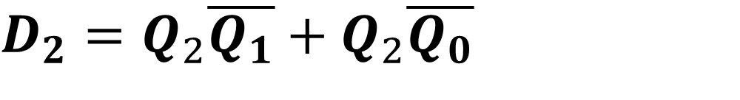
SIMPLIFICATION(K-MAP)
PRESENT STATE |  |  | D FLIP FLOP INPUTS
$$Q_{2}$$ | $$Q_{1}$$ | $$Q_{0}$$ | $$D_{2}$$ | $${D_{1}}_{ }$$ | $$D_{0}$$
0 | 0 | 0 | 0 | 0 | 1
0 | 0 | 1 | 0 | 1 | 0
0 | 1 | 0 | 0 | 1 | 1
0 | 1 | 1 | 1 | 0 | 0
1 | 0 | 0 | 1 | 0 | 1
1 | 0 | 1 | 1 | 1 | 0
1 | 1 | 0 | 1 | 1 | 1
1 | 1 | 1 | 0 | 0 | 0
$$D_{2}$$ |  | $\overline{Q_{1}}$ $\overline{Q_{0}}$ | $$\overline{Q_{1}}Q_{0}$$ | $$Q_{1}Q_{0}$$ | $Q_{1}\overline{Q_{0}}$
 | $Q_{2}$\$Q_{1}Q_{0}$ | 00 | 01 | 11 | 10
$$\overline{Q_{2}}$$ | 0 | 0 | 0 | 1 | 0
$$Q_{2}$$ | 1 | 1 | 1 | 0 | 1
$D_{2}=Q_{2}\overline{Q_{1}}+$ $Q_{2}\overline{Q_{0}}$

Slide 26
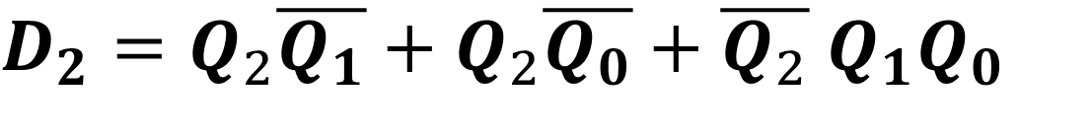
SIMPLIFICATION(K-MAP)
PRESENT STATE |  |  | D FLIP FLOP INPUTS
$$Q_{2}$$ | $$Q_{1}$$ | $$Q_{0}$$ | $$D_{2}$$ | $${D_{1}}_{ }$$ | $$D_{0}$$
0 | 0 | 0 | 0 | 0 | 1
0 | 0 | 1 | 0 | 1 | 0
0 | 1 | 0 | 0 | 1 | 1
0 | 1 | 1 | 1 | 0 | 0
1 | 0 | 0 | 1 | 0 | 1
1 | 0 | 1 | 1 | 1 | 0
1 | 1 | 0 | 1 | 1 | 1
1 | 1 | 1 | 0 | 0 | 0
$$D_{2}$$ |  | $\overline{Q_{1}}$ $\overline{Q_{0}}$ | $$\overline{Q_{1}}Q_{0}$$ | $$Q_{1}Q_{0}$$ | $Q_{1}\overline{Q_{0}}$
 | $Q_{2}$\$Q_{1}Q_{0}$ | 00 | 01 | 11 | 10
$$\overline{Q_{2}}$$ | 0 | 0 | 0 | 1 | 0
$$Q_{2}$$ | 1 | 1 | 1 | 0 | 1
$D_{2}=Q_{2}\overline{Q_{1}}+Q_{2}\overline{Q_{0}}+\overline{Q_{2}}$ $Q_{1}Q_{0}$

Slide 27

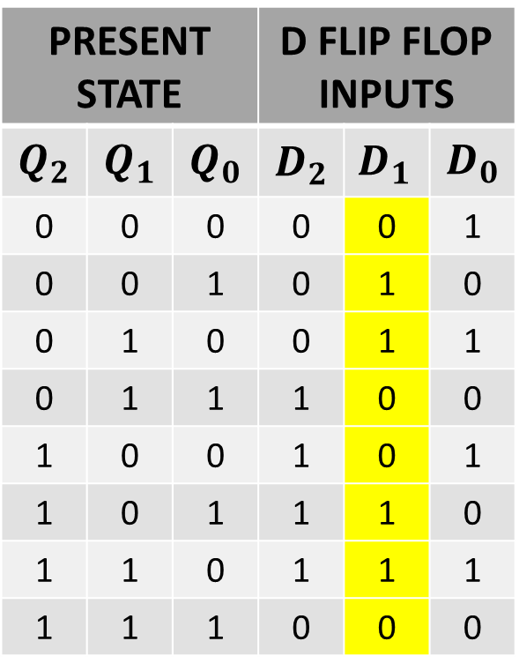
SIMPLIFICATION(K-MAP)
PRESENT STATE |  |  | D FLIP FLOP INPUTS
$$Q_{2}$$ | $$Q_{1}$$ | $$Q_{0}$$ | $$D_{2}$$ | $${D_{1}}_{ }$$ | $$D_{0}$$
0 | 0 | 0 | 0 | 0 | 1
0 | 0 | 1 | 0 | 1 | 0
0 | 1 | 0 | 0 | 1 | 1
0 | 1 | 1 | 1 | 0 | 0
1 | 0 | 0 | 1 | 0 | 1
1 | 0 | 1 | 1 | 1 | 0
1 | 1 | 0 | 1 | 1 | 1
1 | 1 | 1 | 0 | 0 | 0
$$D_{1}$$ |  | $\overline{Q_{1}}$ $\overline{Q_{0}}$ | $$\overline{Q_{1}}Q_{0}$$ | $$Q_{1}Q_{0}$$ | $Q_{1}\overline{Q_{0}}$
 | $Q_{2}$\$Q_{1}Q_{0}$ | 00 | 01 | 11 | 10
$$\overline{Q_{2}}$$ | 0 | 0 | 1 | 0 | 1
$$Q_{2}$$ | 1 | 0 | 1 | 0 | 1

Slide 28
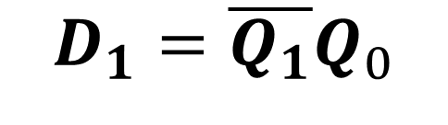
SIMPLIFICATION(K-MAP)
PRESENT STATE |  |  | D FLIP FLOP INPUTS
$$Q_{2}$$ | $$Q_{1}$$ | $$Q_{0}$$ | $$D_{2}$$ | $${D_{1}}_{ }$$ | $$D_{0}$$
0 | 0 | 0 | 0 | 0 | 1
0 | 0 | 1 | 0 | 1 | 0
0 | 1 | 0 | 0 | 1 | 1
0 | 1 | 1 | 1 | 0 | 0
1 | 0 | 0 | 1 | 0 | 1
1 | 0 | 1 | 1 | 1 | 0
1 | 1 | 0 | 1 | 1 | 1
1 | 1 | 1 | 0 | 0 | 0
$$D_{1}$$ |  | $\overline{Q_{1}}$ $\overline{Q_{0}}$ | $$\overline{Q_{1}}Q_{0}$$ | $$Q_{1}Q_{0}$$ | $Q_{1}\overline{Q_{0}}$
 | $Q_{2}$\$Q_{1}Q_{0}$ | 00 | 01 | 11 | 10
$$\overline{Q_{2}}$$ | 0 | 0 | 1 | 0 | 1
$$Q_{2}$$ | 1 | 0 | 1 | 0 | 1
$$D_{1}=\overline{Q_{1}}Q_{0}$$

Slide 29
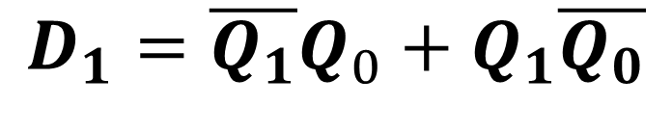

SIMPLIFICATION(K-MAP)
PRESENT STATE |  |  | D FLIP FLOP INPUTS
$$Q_{2}$$ | $$Q_{1}$$ | $$Q_{0}$$ | $$D_{2}$$ | $${D_{1}}_{ }$$ | $$D_{0}$$
0 | 0 | 0 | 0 | 0 | 1
0 | 0 | 1 | 0 | 1 | 0
0 | 1 | 0 | 0 | 1 | 1
0 | 1 | 1 | 1 | 0 | 0
1 | 0 | 0 | 1 | 0 | 1
1 | 0 | 1 | 1 | 1 | 0
1 | 1 | 0 | 1 | 1 | 1
1 | 1 | 1 | 0 | 0 | 0
$$D_{1}$$ |  | $\overline{Q_{1}}$ $\overline{Q_{0}}$ | $$\overline{Q_{1}}Q_{0}$$ | $$Q_{1}Q_{0}$$ | $Q_{1}\overline{Q_{0}}$
 | $Q_{2}$\$Q_{1}Q_{0}$ | 00 | 01 | 11 | 10
$$\overline{Q_{2}}$$ | 0 | 0 | 1 | 0 | 1
$$Q_{2}$$ | 1 | 0 | 1 | 0 | 1
$$D_{1}=\overline{Q_{1}}Q_{0}+Q_{1}\overline{Q_{0}}$$
$$D_{1}=Q_{0} ⨁{ Q}_{1}$$

Slide 30

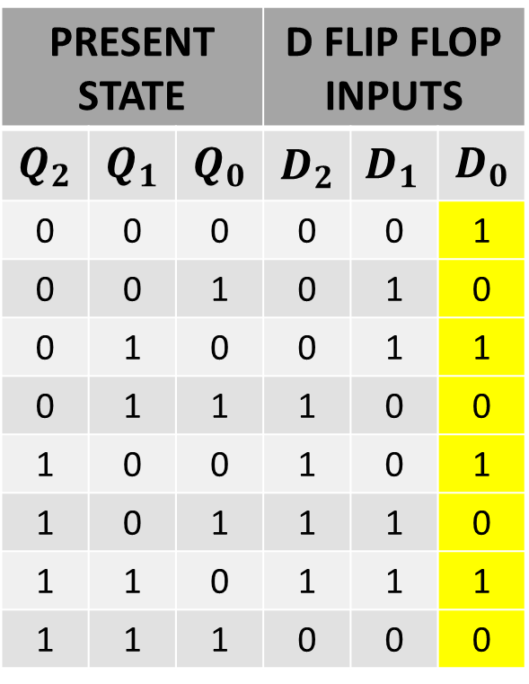
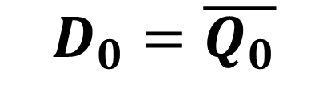
SIMPLIFICATION(K-MAP)
PRESENT STATE |  |  | D FLIP FLOP INPUTS
$$Q_{2}$$ | $$Q_{1}$$ | $$Q_{0}$$ | $$D_{2}$$ | $${D_{1}}_{ }$$ | $$D_{0}$$
0 | 0 | 0 | 0 | 0 | 1
0 | 0 | 1 | 0 | 1 | 0
0 | 1 | 0 | 0 | 1 | 1
0 | 1 | 1 | 1 | 0 | 0
1 | 0 | 0 | 1 | 0 | 1
1 | 0 | 1 | 1 | 1 | 0
1 | 1 | 0 | 1 | 1 | 1
1 | 1 | 1 | 0 | 0 | 0
$$D_{0}$$ |  | $\overline{Q_{1}}$ $\overline{Q_{0}}$ | $$\overline{Q_{1}}Q_{0}$$ | $$Q_{1}Q_{0}$$ | $Q_{1}\overline{Q_{0}}$
 | $Q_{2}$\$Q_{1}Q_{0}$ | 00 | 01 | 11 | 10
$$\overline{Q_{2}}$$ | 0 | 1 | 0 | 0 | 1
$$Q_{2}$$ | 1 | 1 | 0 | 0 | 1
$$D_{0}=\overline{Q_{0}}$$

Slide 31
SIMPLIFICATION(K-MAP)
PRESENT STATE |  |  | D FLIP FLOP INPUTS
$$Q_{2}$$ | $$Q_{1}$$ | $$Q_{0}$$ | $$D_{2}$$ | $${D_{1}}_{ }$$ | $$D_{0}$$
0 | 0 | 0 | 0 | 0 | 1
0 | 0 | 1 | 0 | 1 | 0
0 | 1 | 0 | 0 | 1 | 1
0 | 1 | 1 | 1 | 0 | 0
1 | 0 | 0 | 1 | 0 | 1
1 | 0 | 1 | 1 | 1 | 0
1 | 1 | 0 | 1 | 1 | 1
1 | 1 | 1 | 0 | 0 | 0
$$D_{0}$$ |  | $\overline{Q_{1}}$ $\overline{Q_{0}}$ | $$\overline{Q_{1}}Q_{0}$$ | $$Q_{1}Q_{0}$$ | $Q_{1}\overline{Q_{0}}$
 | $Q_{2}$\$Q_{1}Q_{0}$ | 00 | 01 | 11 | 10
$$\overline{Q_{2}}$$ | 0 | 1 | 0 | 0 | 1
$$Q_{2}$$ | 1 | 1 | 0 | 0 | 1
$$D_{0}=\overline{Q_{0}}$$

Slide 32

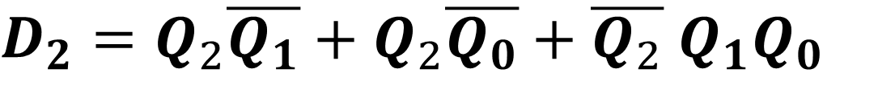
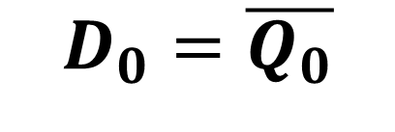
INPUT EQUATIONS
$$D_{0}=\overline{Q_{0}}$$
$$D_{1}=Q_{0} ⨁{ Q}_{1}$$
$D_{2}=Q_{2}\overline{Q_{1}}+Q_{2}\overline{Q_{0}}+\overline{Q_{2}}$ $Q_{1}Q_{0}$

Slide 33
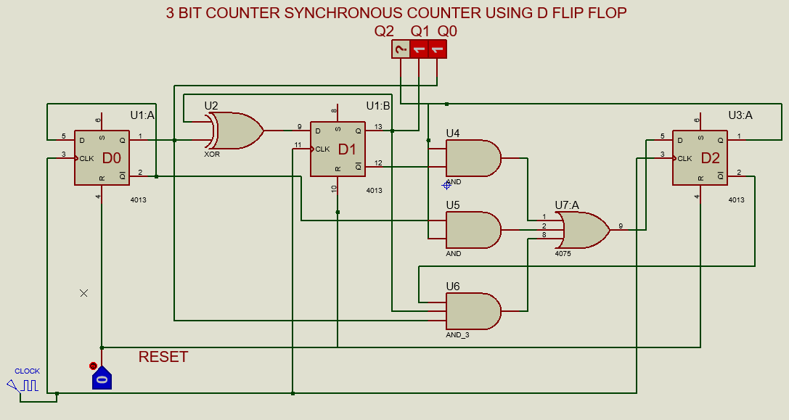
IMPLEMENTATIONS OF EQUATION

Slide 34
NEXT STATE TABLE USING JK FLIP FLOP
PRESENT STATE |  |  | NEXT STATE
$$Q_{2}$$ | $$Q_{1}$$ | $$Q_{0}$$ | $$Q_{2}$$ | $${Q_{1}}_{ }$$ | $$Q_{0}$$
0 | 0 | 0 | 0 | 0 | 1
0 | 0 | 1 | 0 | 1 | 0
0 | 1 | 0 | 0 | 1 | 1
0 | 1 | 1 | 1 | 0 | 0
1 | 0 | 0 | 1 | 0 | 1
1 | 0 | 1 | 1 | 1 | 0
1 | 1 | 0 | 1 | 1 | 1
1 | 1 | 1 | 0 | 0 | 0

Slide 35
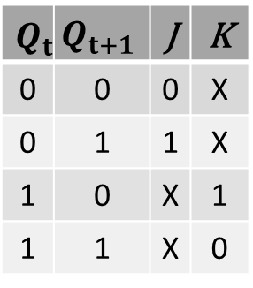
NEXT STATE TABLE USING JK FLIP FLOP
$$Q_{t}$$ | $$Q_{t+1}$$ | J | K
0 | 0 | 0 | X
0 | 1 | 1 | X
1 | 0 | X | 1
1 | 1 | X | 0
PRESENT STATE |  |  | NEXT STATE
$$Q_{2}$$ | $$Q_{1}$$ | $$Q_{0}$$ | $$Q_{2}$$ | $${Q_{1}}_{ }$$ | $$Q_{0}$$
0 | 0 | 0 | 0 | 0 | 1
0 | 0 | 1 | 0 | 1 | 0
0 | 1 | 0 | 0 | 1 | 1
0 | 1 | 1 | 1 | 0 | 0
1 | 0 | 0 | 1 | 0 | 1
1 | 0 | 1 | 1 | 1 | 0
1 | 1 | 0 | 1 | 1 | 1
1 | 1 | 1 | 0 | 0 | 0

Slide 36
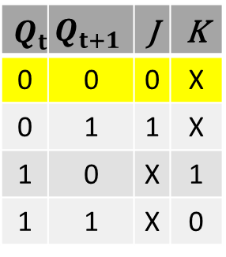
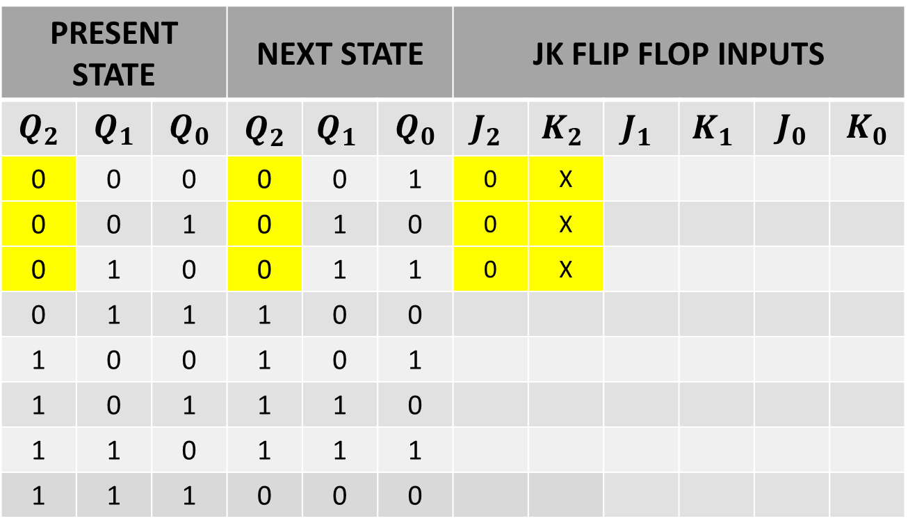
NEXT STATE TABLE USING JK FLIP FLOP FOR FF2
$$Q_{t}$$ | $$Q_{t+1}$$ | J | K
0 | 0 | 0 | X
0 | 1 | 1 | X
1 | 0 | X | 1
1 | 1 | X | 0
PRESENT STATE |  |  | NEXT STATE |  |  | JK FLIP FLOP INPUTS
$$Q_{2}$$ | $$Q_{1}$$ | $$Q_{0}$$ | $$Q_{2}$$ | $${Q_{1}}_{ }$$ | $$Q_{0}$$ | $${J_{2}}_{ }$$ | $${K_{2}}_{ }$$ | $${J_{1}}_{ }$$ | $${K_{1}}_{ }$$ | $$J_{0}$$ | $$K_{0}$$
0 | 0 | 0 | 0 | 0 | 1 | 0 | X
0 | 0 | 1 | 0 | 1 | 0 | 0 | X
0 | 1 | 0 | 0 | 1 | 1 | 0 | X
0 | 1 | 1 | 1 | 0 | 0
1 | 0 | 0 | 1 | 0 | 1
1 | 0 | 1 | 1 | 1 | 0
1 | 1 | 0 | 1 | 1 | 1
1 | 1 | 1 | 0 | 0 | 0

Slide 37
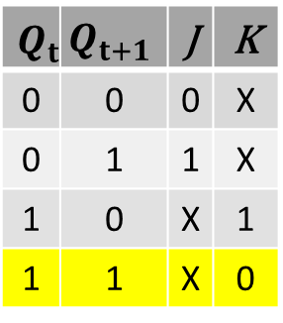
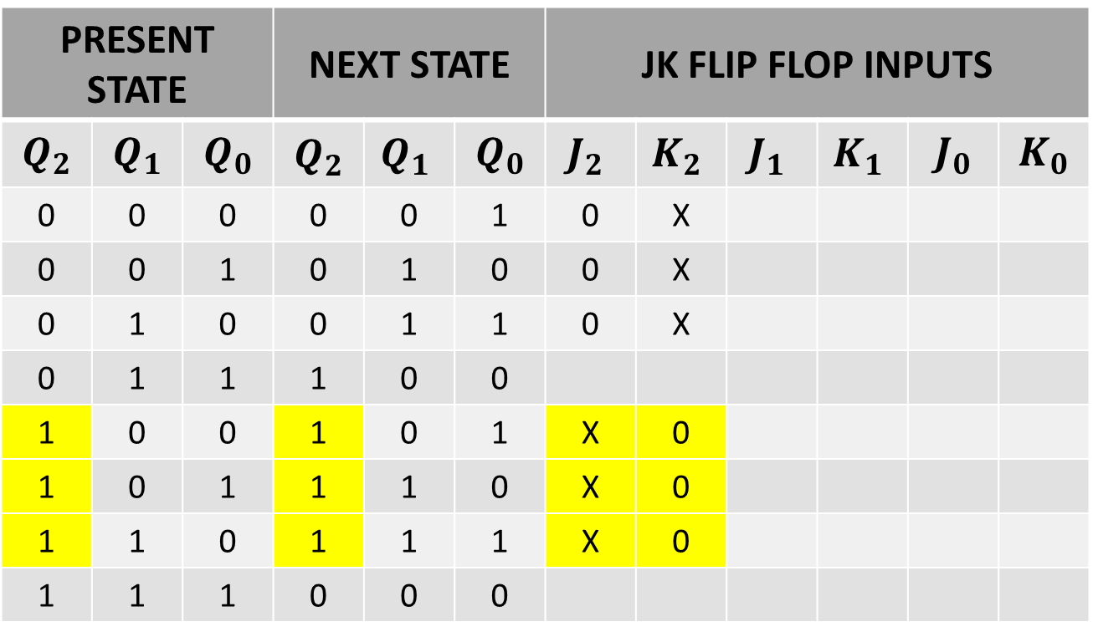
NEXT STATE TABLE USING JK FLIP FLOP FOR FF2
$$Q_{t}$$ | $$Q_{t+1}$$ | J | K
0 | 0 | 0 | X
0 | 1 | 1 | X
1 | 0 | X | 1
1 | 1 | X | 0
PRESENT STATE |  |  | NEXT STATE |  |  | JK FLIP FLOP INPUTS
$$Q_{2}$$ | $$Q_{1}$$ | $$Q_{0}$$ | $$Q_{2}$$ | $${Q_{1}}_{ }$$ | $$Q_{0}$$ | $${J_{2}}_{ }$$ | $${K_{2}}_{ }$$ | $${J_{1}}_{ }$$ | $${K_{1}}_{ }$$ | $$J_{0}$$ | $$K_{0}$$
0 | 0 | 0 | 0 | 0 | 1 | 0 | X
0 | 0 | 1 | 0 | 1 | 0 | 0 | X
0 | 1 | 0 | 0 | 1 | 1 | 0 | X
0 | 1 | 1 | 1 | 0 | 0
1 | 0 | 0 | 1 | 0 | 1 | X | 0
1 | 0 | 1 | 1 | 1 | 0 | X | 0
1 | 1 | 0 | 1 | 1 | 1 | X | 0
1 | 1 | 1 | 0 | 0 | 0

Slide 38
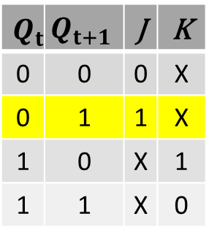

NEXT STATE TABLE USING JK FLIP FLOP FOR FF2
$$Q_{t}$$ | $$Q_{t+1}$$ | J | K
0 | 0 | 0 | X
0 | 1 | 1 | X
1 | 0 | X | 1
1 | 1 | X | 0
PRESENT STATE |  |  | NEXT STATE |  |  | JK FLIP FLOP INPUTS
$$Q_{2}$$ | $$Q_{1}$$ | $$Q_{0}$$ | $$Q_{2}$$ | $${Q_{1}}_{ }$$ | $$Q_{0}$$ | $${J_{2}}_{ }$$ | $${K_{2}}_{ }$$ | $${J_{1}}_{ }$$ | $${K_{1}}_{ }$$ | $$J_{0}$$ | $$K_{0}$$
0 | 0 | 0 | 0 | 0 | 1 | 0 | X
0 | 0 | 1 | 0 | 1 | 0 | 0 | X
0 | 1 | 0 | 0 | 1 | 1 | 0 | X
0 | 1 | 1 | 1 | 0 | 0 | 1 | X
1 | 0 | 0 | 1 | 0 | 1 | X | 0
1 | 0 | 1 | 1 | 1 | 0 | X | 0
1 | 1 | 0 | 1 | 1 | 1 | X | 0
1 | 1 | 1 | 0 | 0 | 0

Slide 39


NEXT STATE TABLE USING JK FLIP FLOP FOR FF2
$$Q_{t}$$ | $$Q_{t+1}$$ | J | K
0 | 0 | 0 | X
0 | 1 | 1 | X
1 | 0 | X | 1
1 | 1 | X | 0
PRESENT STATE |  |  | NEXT STATE |  |  | JK FLIP FLOP INPUTS
$$Q_{2}$$ | $$Q_{1}$$ | $$Q_{0}$$ | $$Q_{2}$$ | $${Q_{1}}_{ }$$ | $$Q_{0}$$ | $${J_{2}}_{ }$$ | $${K_{2}}_{ }$$ | $${J_{1}}_{ }$$ | $${K_{1}}_{ }$$ | $$J_{0}$$ | $$K_{0}$$
0 | 0 | 0 | 0 | 0 | 1 | 0 | X
0 | 0 | 1 | 0 | 1 | 0 | 0 | X
0 | 1 | 0 | 0 | 1 | 1 | 0 | X
0 | 1 | 1 | 1 | 0 | 0 | 1 | X
1 | 0 | 0 | 1 | 0 | 1 | X | 0
1 | 0 | 1 | 1 | 1 | 0 | X | 0
1 | 1 | 0 | 1 | 1 | 1 | X | 0
1 | 1 | 1 | 0 | 0 | 0 | X | 1

Slide 40

NEXT STATE TABLE USING JK FLIP FLOP FOR FF1
$$Q_{t}$$ | $$Q_{t+1}$$ | J | K
0 | 0 | 0 | X
0 | 1 | 1 | X
1 | 0 | X | 1
1 | 1 | X | 0
PRESENT STATE |  |  | NEXT STATE |  |  | JK FLIP FLOP INPUTS
$$Q_{2}$$ | $$Q_{1}$$ | $$Q_{0}$$ | $$Q_{2}$$ | $${Q_{1}}_{ }$$ | $$Q_{0}$$ | $${J_{2}}_{ }$$ | $${K_{2}}_{ }$$ | $${J_{1}}_{ }$$ | $${K_{1}}_{ }$$ | $$J_{0}$$ | $$K_{0}$$
0 | 0 | 0 | 0 | 0 | 1 | 0 | X | 0 | X
0 | 0 | 1 | 0 | 1 | 0 | 0 | X
0 | 1 | 0 | 0 | 1 | 1 | 0 | X
0 | 1 | 1 | 1 | 0 | 0 | 1 | X
1 | 0 | 0 | 1 | 0 | 1 | X | 0 | 0 | X
1 | 0 | 1 | 1 | 1 | 0 | X | 0
1 | 1 | 0 | 1 | 1 | 1 | X | 0
1 | 1 | 1 | 0 | 0 | 0 | X | 1

Slide 41

NEXT STATE TABLE USING JK FLIP FLOP FOR FF1
$$Q_{t}$$ | $$Q_{t+1}$$ | J | K
0 | 0 | 0 | X
0 | 1 | 1 | X
1 | 0 | X | 1
1 | 1 | X | 0
PRESENT STATE |  |  | NEXT STATE |  |  | JK FLIP FLOP INPUTS
$$Q_{2}$$ | $$Q_{1}$$ | $$Q_{0}$$ | $$Q_{2}$$ | $${Q_{1}}_{ }$$ | $$Q_{0}$$ | $${J_{2}}_{ }$$ | $${K_{2}}_{ }$$ | $${J_{1}}_{ }$$ | $${K_{1}}_{ }$$ | $$J_{0}$$ | $$K_{0}$$
0 | 0 | 0 | 0 | 0 | 1 | 0 | X | 0 | X
0 | 0 | 1 | 0 | 1 | 0 | 0 | X | 1 | X
0 | 1 | 0 | 0 | 1 | 1 | 0 | X
0 | 1 | 1 | 1 | 0 | 0 | 1 | X
1 | 0 | 0 | 1 | 0 | 1 | X | 0 | 0 | X
1 | 0 | 1 | 1 | 1 | 0 | X | 0 | 1 | X
1 | 1 | 0 | 1 | 1 | 1 | X | 0
1 | 1 | 1 | 0 | 0 | 0 | X | 1

Slide 42

NEXT STATE TABLE USING JK FLIP FLOP FOR FF1
$$Q_{t}$$ | $$Q_{t+1}$$ | J | K
0 | 0 | 0 | X
0 | 1 | 1 | X
1 | 0 | X | 1
1 | 1 | X | 0
PRESENT STATE |  |  | NEXT STATE |  |  | JK FLIP FLOP INPUTS
$$Q_{2}$$ | $$Q_{1}$$ | $$Q_{0}$$ | $$Q_{2}$$ | $${Q_{1}}_{ }$$ | $$Q_{0}$$ | $${J_{2}}_{ }$$ | $${K_{2}}_{ }$$ | $${J_{1}}_{ }$$ | $${K_{1}}_{ }$$ | $$J_{0}$$ | $$K_{0}$$
0 | 0 | 0 | 0 | 0 | 1 | 0 | X | 0 | X
0 | 0 | 1 | 0 | 1 | 0 | 0 | X | 1 | X
0 | 1 | 0 | 0 | 1 | 1 | 0 | X | X | 0
0 | 1 | 1 | 1 | 0 | 0 | 1 | X
1 | 0 | 0 | 1 | 0 | 1 | X | 0 | 0 | X
1 | 0 | 1 | 1 | 1 | 0 | X | 0 | 1 | X
1 | 1 | 0 | 1 | 1 | 1 | X | 0 | X | 0
1 | 1 | 1 | 0 | 0 | 0 | X | 1

Slide 43

NEXT STATE TABLE USING JK FLIP FLOP FOR FF1
$$Q_{t}$$ | $$Q_{t+1}$$ | J | K
0 | 0 | 0 | X
0 | 1 | 1 | X
1 | 0 | X | 1
1 | 1 | X | 0
PRESENT STATE |  |  | NEXT STATE |  |  | JK FLIP FLOP INPUTS
$$Q_{2}$$ | $$Q_{1}$$ | $$Q_{0}$$ | $$Q_{2}$$ | $${Q_{1}}_{ }$$ | $$Q_{0}$$ | $${J_{2}}_{ }$$ | $${K_{2}}_{ }$$ | $${J_{1}}_{ }$$ | $${K_{1}}_{ }$$ | $$J_{0}$$ | $$K_{0}$$
0 | 0 | 0 | 0 | 0 | 1 | 0 | X | 0 | X
0 | 0 | 1 | 0 | 1 | 0 | 0 | X | 1 | X
0 | 1 | 0 | 0 | 1 | 1 | 0 | X | X | 0
0 | 1 | 1 | 1 | 0 | 0 | 1 | X | X | 1
1 | 0 | 0 | 1 | 0 | 1 | X | 0 | 0 | X
1 | 0 | 1 | 1 | 1 | 0 | X | 0 | 1 | X
1 | 1 | 0 | 1 | 1 | 1 | X | 0 | X | 0
1 | 1 | 1 | 0 | 0 | 0 | X | 1 | X | 1

Slide 44

NEXT STATE TABLE USING JK FLIP FLOP FOR FF0
$$Q_{t}$$ | $$Q_{t+1}$$ | J | K
0 | 0 | 0 | X
0 | 1 | 1 | X
1 | 0 | X | 1
1 | 1 | X | 0
PRESENT STATE |  |  | NEXT STATE |  |  | JK FLIP FLOP INPUTS
$$Q_{2}$$ | $$Q_{1}$$ | $$Q_{0}$$ | $$Q_{2}$$ | $${Q_{1}}_{ }$$ | $$Q_{0}$$ | $${J_{2}}_{ }$$ | $${K_{2}}_{ }$$ | $${J_{1}}_{ }$$ | $${K_{1}}_{ }$$ | $$J_{0}$$ | $$K_{0}$$
0 | 0 | 0 | 0 | 0 | 1 | 0 | X | 0 | X | 1 | X
0 | 0 | 1 | 0 | 1 | 0 | 0 | X | 1 | X
0 | 1 | 0 | 0 | 1 | 1 | 0 | X | X | 0 | 1 | X
0 | 1 | 1 | 1 | 0 | 0 | 1 | X | X | 1
1 | 0 | 0 | 1 | 0 | 1 | X | 0 | 0 | X | 1 | X
1 | 0 | 1 | 1 | 1 | 0 | X | 0 | 1 | X
1 | 1 | 0 | 1 | 1 | 1 | X | 0 | X | 0 | 1 | X
1 | 1 | 1 | 0 | 0 | 0 | X | 1 | X | 1

Slide 45

NEXT STATE TABLE USING JK FLIP FLOP FOR FF0
$$Q_{t}$$ | $$Q_{t+1}$$ | J | K
0 | 0 | 0 | X
0 | 1 | 1 | X
1 | 0 | X | 1
1 | 1 | X | 0
PRESENT STATE |  |  | NEXT STATE |  |  | JK FLIP FLOP INPUTS
$$Q_{2}$$ | $$Q_{1}$$ | $$Q_{0}$$ | $$Q_{2}$$ | $${Q_{1}}_{ }$$ | $$Q_{0}$$ | $${J_{2}}_{ }$$ | $${K_{2}}_{ }$$ | $${J_{1}}_{ }$$ | $${K_{1}}_{ }$$ | $$J_{0}$$ | $$K_{0}$$
0 | 0 | 0 | 0 | 0 | 1 | 0 | X | 0 | X | 1 | X
0 | 0 | 1 | 0 | 1 | 0 | 0 | X | 1 | X | X | 1
0 | 1 | 0 | 0 | 1 | 1 | 0 | X | X | 0 | 1 | X
0 | 1 | 1 | 1 | 0 | 0 | 1 | X | X | 1 | X | 1
1 | 0 | 0 | 1 | 0 | 1 | X | 0 | 0 | X | 1 | X
1 | 0 | 1 | 1 | 1 | 0 | X | 0 | 1 | X | X | 1
1 | 1 | 0 | 1 | 1 | 1 | X | 0 | X | 0 | 1 | X
1 | 1 | 1 | 0 | 0 | 0 | X | 1 | X | 1 | X | 1

Slide 46

NEXT STATE TABLE USING JK FLIP FLOP FOR FF1
PRESENT STATE |  |  | JK FLIP FLOP INPUTS
$$Q_{2}$$ | $$Q_{1}$$ | $$Q_{0}$$ | $${J_{2}}_{ }$$ | $${K_{2}}_{ }$$ | $${J_{1}}_{ }$$ | $${K_{1}}_{ }$$ | $$J_{0}$$ | $$K_{0}$$
0 | 0 | 0 | 0 | X | 0 | X | 1 | X
0 | 0 | 1 | 0 | X | 1 | X | X | 1
0 | 1 | 0 | 0 | X | X | 0 | 1 | X
0 | 1 | 1 | 1 | X | X | 1 | X | 1
1 | 0 | 0 | X | 0 | 0 | X | 1 | X
1 | 0 | 1 | X | 0 | 1 | X | X | 1
1 | 1 | 0 | X | 0 | X | 0 | 1 | X
1 | 1 | 1 | X | 1 | X | 1 | X | 1

Slide 47



SIMPLIFICATION(K-MAP)
PRESENT STATE |  |  | JK FLIP FLOP INPUTS
$$Q_{2}$$ | $$Q_{1}$$ | $$Q_{0}$$ | $${J_{2}}_{ }$$ | $${K_{2}}_{ }$$ | $${J_{1}}_{ }$$ | $${K_{1}}_{ }$$ | $$J_{0}$$ | $$K_{0}$$
0 | 0 | 0 | 0 | X | 0 | X | 1 | X
0 | 0 | 1 | 0 | X | 1 | X | X | 1
0 | 1 | 0 | 0 | X | X | 0 | 1 | X
0 | 1 | 1 | 1 | X | X | 1 | X | 1
1 | 0 | 0 | X | 0 | 0 | X | 1 | X
1 | 0 | 1 | X | 0 | 1 | X | X | 1
1 | 1 | 0 | X | 0 | X | 0 | 1 | X
1 | 1 | 1 | X | 1 | X | 1 | X | 1
$$J_{2}$$ |  | $\overline{Q_{1}}$ $\overline{Q_{0}}$ | $$\overline{Q_{1}}Q_{0}$$ | $$Q_{1}Q_{0}$$ | $Q_{1}\overline{Q_{0}}$
 | $Q_{2}$\$Q_{1}Q_{0}$ | 00 | 01 | 11 | 10
$$\overline{Q_{2}}$$ | 0 | 0 | 0 | 1 | 0
$$Q_{2}$$ | 1 | X | X | X | X
$$J_{2}=Q_{1}Q_{0}$$

Slide 48



SIMPLIFICATION(K-MAP)
PRESENT STATE |  |  | JK FLIP FLOP INPUTS
$$Q_{2}$$ | $$Q_{1}$$ | $$Q_{0}$$ | $${J_{2}}_{ }$$ | $${K_{2}}_{ }$$ | $${J_{1}}_{ }$$ | $${K_{1}}_{ }$$ | $$J_{0}$$ | $$K_{0}$$
0 | 0 | 0 | 0 | X | 0 | X | 1 | X
0 | 0 | 1 | 0 | X | 1 | X | X | 1
0 | 1 | 0 | 0 | X | X | 0 | 1 | X
0 | 1 | 1 | 1 | X | X | 1 | X | 1
1 | 0 | 0 | X | 0 | 0 | X | 1 | X
1 | 0 | 1 | X | 0 | 1 | X | X | 1
1 | 1 | 0 | X | 0 | X | 0 | 1 | X
1 | 1 | 1 | X | 1 | X | 1 | X | 1
$$K_{2}$$ |  | $\overline{Q_{1}}$ $\overline{Q_{0}}$ | $$\overline{Q_{1}}Q_{0}$$ | $$Q_{1}Q_{0}$$ | $Q_{1}\overline{Q_{0}}$
 | $Q_{2}$\$Q_{1}Q_{0}$ | 00 | 01 | 11 | 10
$$\overline{Q_{2}}$$ | 0 | X | X | X | X
$$Q_{2}$$ | 1 | 0 | 0 | 1 | 0
$$K_{2}=Q_{1}Q_{0}$$

Slide 49



SIMPLIFICATION(K-MAP)
PRESENT STATE |  |  | JK FLIP FLOP INPUTS
$$Q_{2}$$ | $$Q_{1}$$ | $$Q_{0}$$ | $${J_{2}}_{ }$$ | $${K_{2}}_{ }$$ | $${J_{1}}_{ }$$ | $${K_{1}}_{ }$$ | $$J_{0}$$ | $$K_{0}$$
0 | 0 | 0 | 0 | X | 0 | X | 1 | X
0 | 0 | 1 | 0 | X | 1 | X | X | 1
0 | 1 | 0 | 0 | X | X | 0 | 1 | X
0 | 1 | 1 | 1 | X | X | 1 | X | 1
1 | 0 | 0 | X | 0 | 0 | X | 1 | X
1 | 0 | 1 | X | 0 | 1 | X | X | 1
1 | 1 | 0 | X | 0 | X | 0 | 1 | X
1 | 1 | 1 | X | 1 | X | 1 | X | 1
$$J_{1}$$ |  | $\overline{Q_{1}}$ $\overline{Q_{0}}$ | $$\overline{Q_{1}}Q_{0}$$ | $$Q_{1}Q_{0}$$ | $Q_{1}\overline{Q_{0}}$
 | $Q_{2}$\$Q_{1}Q_{0}$ | 00 | 01 | 11 | 10
$$\overline{Q_{2}}$$ | 0 | 0 | 1 | X | X
$$Q_{2}$$ | 1 | 0 | 1 | X | X
$$J_{1}=Q_{0}$$

Slide 50



SIMPLIFICATION(K-MAP)
PRESENT STATE |  |  | JK FLIP FLOP INPUTS
$$Q_{2}$$ | $$Q_{1}$$ | $$Q_{0}$$ | $${J_{2}}_{ }$$ | $${K_{2}}_{ }$$ | $${J_{1}}_{ }$$ | $${K_{1}}_{ }$$ | $$J_{0}$$ | $$K_{0}$$
0 | 0 | 0 | 0 | X | 0 | X | 1 | X
0 | 0 | 1 | 0 | X | 1 | X | X | 1
0 | 1 | 0 | 0 | X | X | 0 | 1 | X
0 | 1 | 1 | 1 | X | X | 1 | X | 1
1 | 0 | 0 | X | 0 | 0 | X | 1 | X
1 | 0 | 1 | X | 0 | 1 | X | X | 1
1 | 1 | 0 | X | 0 | X | 0 | 1 | X
1 | 1 | 1 | X | 1 | X | 1 | X | 1
$$K_{1}$$ |  | $\overline{Q_{1}}$ $\overline{Q_{0}}$ | $$\overline{Q_{1}}Q_{0}$$ | $$Q_{1}Q_{0}$$ | $Q_{1}\overline{Q_{0}}$
 | $Q_{2}$\$Q_{1}Q_{0}$ | 00 | 01 | 11 | 10
$$\overline{Q_{2}}$$ | 0 | X | X | 1 | 0
$$Q_{2}$$ | 1 | X | X | 1 | 0
$$K_{1}=Q_{0}$$

Slide 51



SIMPLIFICATION(K-MAP)
PRESENT STATE |  |  | JK FLIP FLOP INPUTS
$$Q_{2}$$ | $$Q_{1}$$ | $$Q_{0}$$ | $${J_{2}}_{ }$$ | $${K_{2}}_{ }$$ | $${J_{1}}_{ }$$ | $${K_{1}}_{ }$$ | $$J_{0}$$ | $$K_{0}$$
0 | 0 | 0 | 0 | X | 0 | X | 1 | X
0 | 0 | 1 | 0 | X | 1 | X | X | 1
0 | 1 | 0 | 0 | X | X | 0 | 1 | X
0 | 1 | 1 | 1 | X | X | 1 | X | 1
1 | 0 | 0 | X | 0 | 0 | X | 1 | X
1 | 0 | 1 | X | 0 | 1 | X | X | 1
1 | 1 | 0 | X | 0 | X | 0 | 1 | X
1 | 1 | 1 | X | 1 | X | 1 | X | 1
$$J_{0}$$ |  | $\overline{Q_{1}}$ $\overline{Q_{0}}$ | $$\overline{Q_{1}}Q_{0}$$ | $$Q_{1}Q_{0}$$ | $Q_{1}\overline{Q_{0}}$
 | $Q_{2}$\$Q_{1}Q_{0}$ | 00 | 01 | 11 | 10
$$\overline{Q_{2}}$$ | 0 | 1 | X | X | 1
$$Q_{2}$$ | 1 | 1 | X | X | 1
$$J_{0}=1$$

Slide 52



SIMPLIFICATION(K-MAP)
PRESENT STATE |  |  | JK FLIP FLOP INPUTS
$$Q_{2}$$ | $$Q_{1}$$ | $$Q_{0}$$ | $${J_{2}}_{ }$$ | $${K_{2}}_{ }$$ | $${J_{1}}_{ }$$ | $${K_{1}}_{ }$$ | $$J_{0}$$ | $$K_{0}$$
0 | 0 | 0 | 0 | X | 0 | X | 1 | X
0 | 0 | 1 | 0 | X | 1 | X | X | 1
0 | 1 | 0 | 0 | X | X | 0 | 1 | X
0 | 1 | 1 | 1 | X | X | 1 | X | 1
1 | 0 | 0 | X | 0 | 0 | X | 1 | X
1 | 0 | 1 | X | 0 | 1 | X | X | 1
1 | 1 | 0 | X | 0 | X | 0 | 1 | X
1 | 1 | 1 | X | 1 | X | 1 | X | 1
$$K_{0}$$ |  | $\overline{Q_{1}}$ $\overline{Q_{0}}$ | $$\overline{Q_{1}}Q_{0}$$ | $$Q_{1}Q_{0}$$ | $Q_{1}\overline{Q_{0}}$
 | $Q_{2}$\$Q_{1}Q_{0}$ | 00 | 01 | 11 | 10
$$\overline{Q_{2}}$$ | 0 | X | 1 | 1 | X
$$Q_{2}$$ | 1 | X | 1 | 1 | X
$$K_{0}=1$$

Slide 53






INPUT EQUATIONS
$$J_{2}=Q_{1}Q_{0}$$
$$K_{2}=Q_{1}Q_{0}$$
$$J_{1}=Q_{0}$$
$$K_{1}=Q_{0}$$
$$J_{0}=1$$
$$K_{0}=1$$

Slide 54

IMPLEMENTATIONS OF EQUATION

